Slide 1


Car Price Prediction with Linear Regression
This presentation explores a Python-based linear regression model. It predicts car prices using the scikit-learn library. Key steps include data preprocessing, model training, and performance evaluation.
by Ibrahim Abdel Nasser

Slide 2
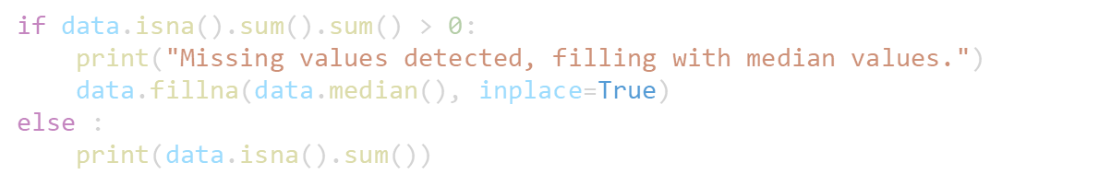
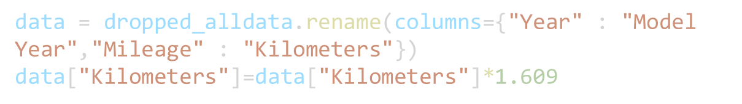
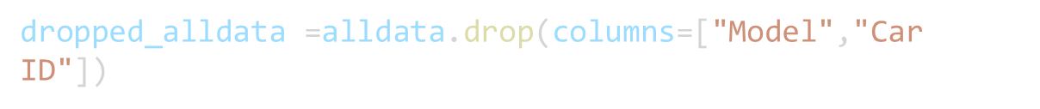

Data Loading and Preprocessing
Loading the Dataset
Rename and Drop Data
Handling Missing Data
Feature Engineering
First, import pandas to read the car_prediction_data.csv file.
Drop unneeded data (Car ID).
Rename some of data (from Mileage to Kilometers).
Then, fill missing values with the median. This ensures data completeness.
Convert "Mileage" from miles to kilometers. Rename columns to improve readability.
https://www.kaggle.com/datasets/zafarali27/car-price-prediction

Slide 3
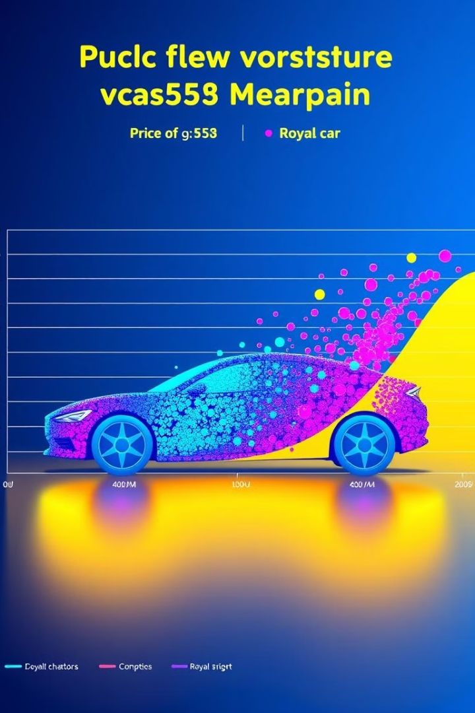
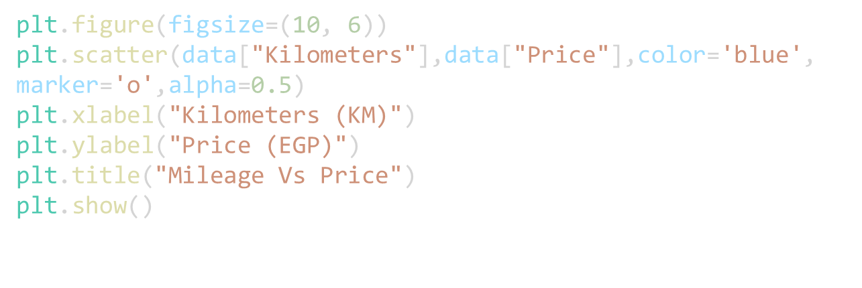
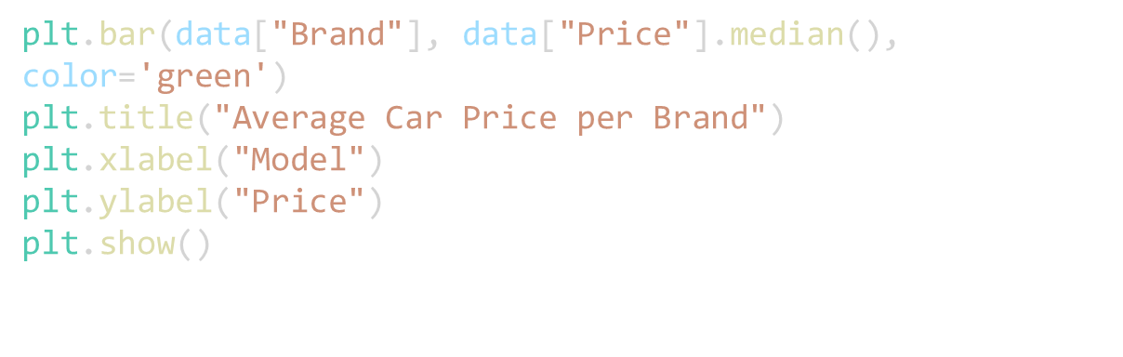
Exploratory Data Analysis
1
Kilometers vs. Price
A scatter plot visualizes the relationship. Price typically decreases as mileage increases.
2
Average Price per Brand
A bar chart displays median car prices. Each bar represents the median price per brand.

Slide 4
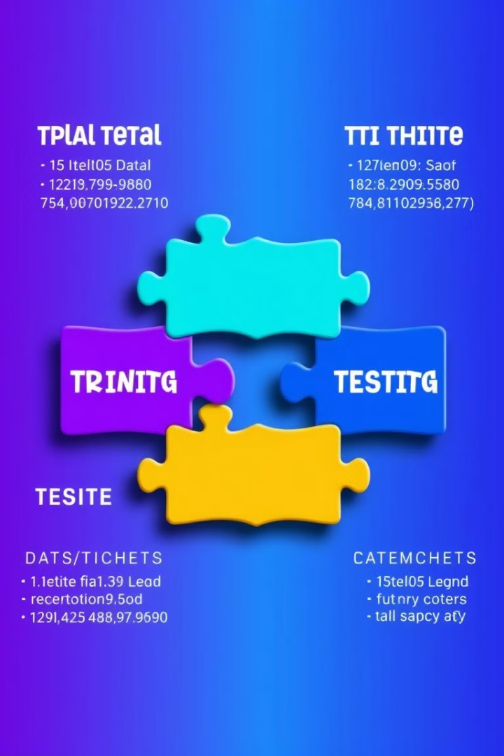



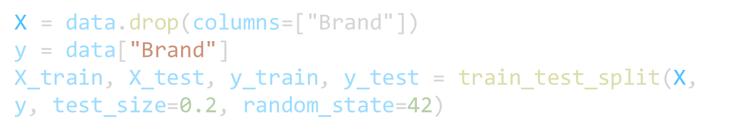
Data Splitting
Train-Test Split
train_test_split divides data.
80/20 Ratio
80% of data is for training and 20% is for testing.
Random State
random_state=42 ensures reproducibility.

Slide 5




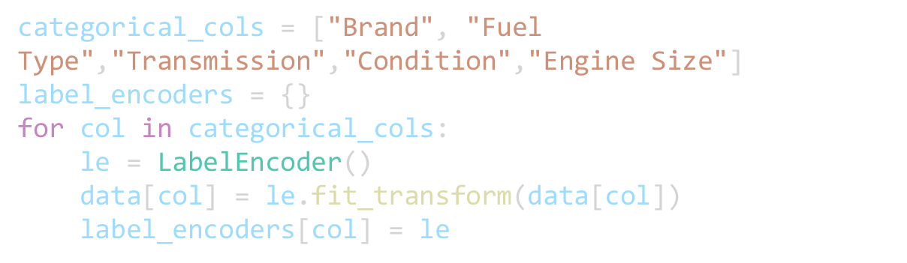
Feature Selection and Encoding
Categorical columns include Brand, Fuel Type, Transmission, Condition, and Engine Size.
LabelEncoder from scikit-learn converts categories to numerical labels.
Features are selected for model training after encoding is complete.

Slide 6
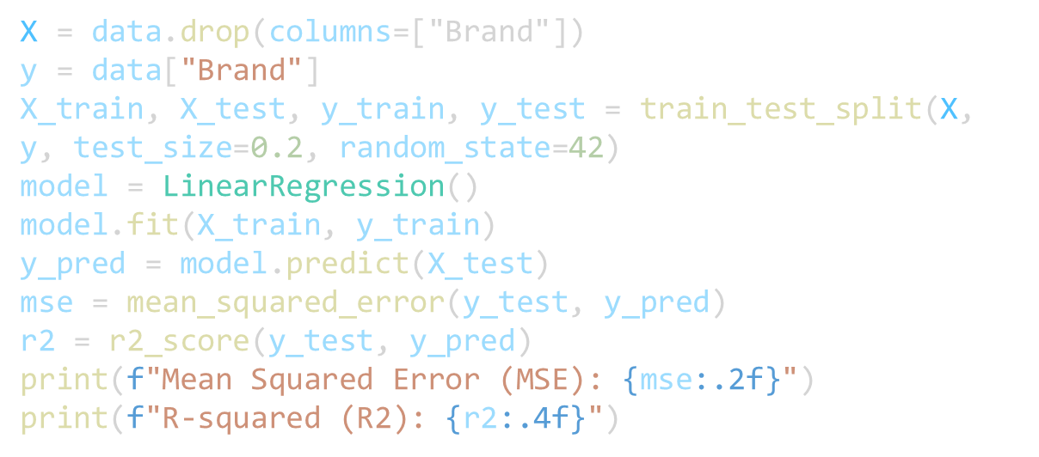
Model Training
Linear Regression
1
A LinearRegression model is initialized from sklearn.linear_model.
Model Fitting
2
The model learns from training data. It finds coefficients.
Prediction
3
The model predicts on the test set.

Slide 7


Model Evaluation
1
R-squared
Mean Squared Error
R2 indicates model fit. Ranges from 0 to 1.
MSE measures prediction accuracy.
2

Slide 8

Summary and Next Steps
Key Takeaways
Linear regression predicts car prices. Scikit-learn simplifies the process.
Further Exploration
Improve the model with more features. Consider other regression models.

